Slide 1
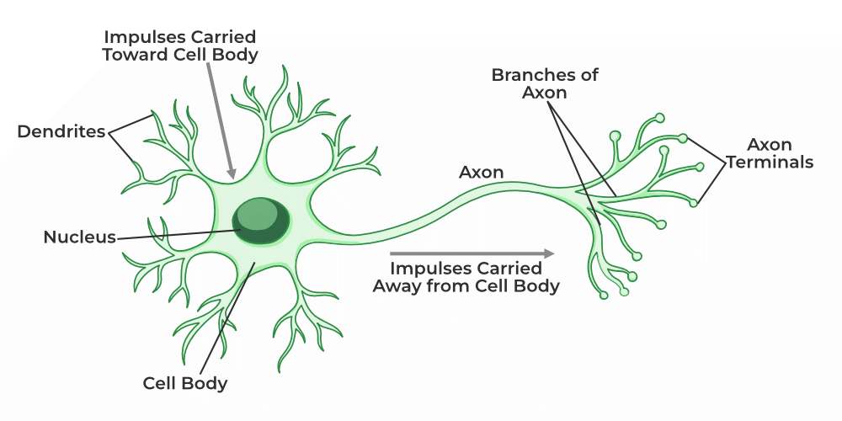
Tutorial 3
﻿CS5486 Intelligent Systems:
McCulloch-Pitts Neuron and Perceptron
Hongzong Li
Department of Computer Science City University of Hong Kong

Slide 2
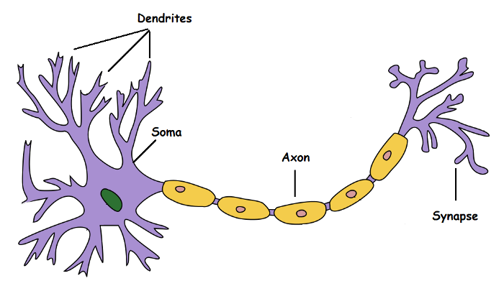
Biological Neurons: An Overly Simplified Illustration
Dendrite: Receives signals from other neurons
Soma: Processes the information
Axon: Transmits the output of this neuron
Synapse: is a Point of connection to other neurons
Notes:
It is very well known that the most fundamental unit of deep neural networks is called an artificial neuron/perceptron. But the very first step towards the perceptron we use today was taken in 1943 by McCulloch and Pitts, by mimicking the functionality of a biological neuron.

Slide 3
Biological Neurons: An Overly Simplified Illustration
Input signal
CPU
cable
…
Notes:
Basically, a neuron takes an input signal using dendrite, processes it like the CPU (soma), passes the output through a cable-like structure to other connected neurons (axon to synapse to other neuron’s dendrite). This might be biologically inaccurate as there is a lot more going on out there but on a higher level, this is what is going on with a neuron in our brain — takes an input, processes it, throws out an output.

Slide 4
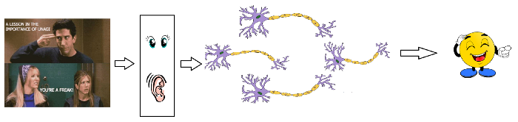
Biological Neurons: An Overly Simplified Illustration
Notes:
Our sense organs interact with the outer world and send the visual and sound information to the neurons. Let's say you are watching Friends. Now the information your brain receives is taken in by the “laugh or not” set of neurons that will help you make a decision on whether to laugh or not. Each neuron gets fired/activated only when its respective criteria (more on this later) is met

Slide 5
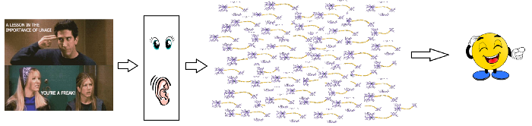
Biological Neurons: An Overly Simplified Illustration
A massively parallel interconnected network of 10¹¹ neurons (100 billion) in our brain
Notes:
Of course, this is not entirely true. In reality, it is not just a couple of neurons which would do the decision making. There is a massively parallel interconnected network of 10¹¹ neurons (100 billion) in our brain and their connections are not as simple as I showed you above. It might look something like this:

Slide 6
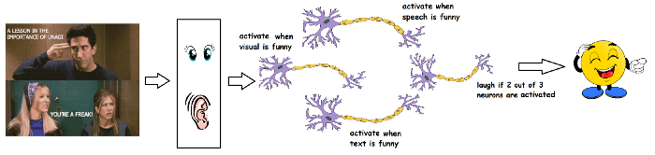
Biological Neurons: An Overly Simplified Illustration
In a hierarchical manner
Notes:
Now the sense organs pass the information to the lowest layer of neurons to process it. And the output of the processes is passed on to the next layers in a hierarchical manner, some of the neurons will fire and some won’t and this process goes on until it results in a final response.

Slide 7
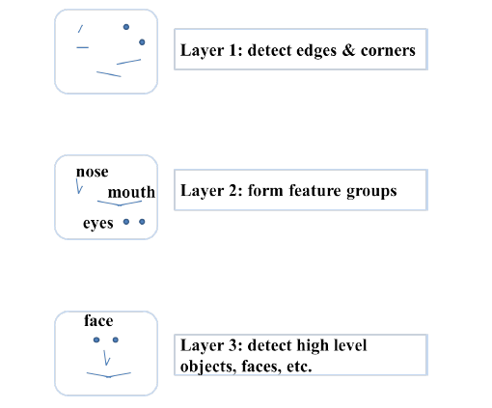
Biological Neurons: An Overly Simplified Illustration
Notes:
This massively parallel network also ensures that there is a division of work. Each neuron only fires when its intended criteria is met i.e., a neuron may perform a certain role to a certain stimulus, as shown below.
It is believed that neurons are arranged in a hierarchical fashion and each layer has its own role and responsibility. To detect a face, the brain could be relying on the entire network and not on a single layer.

Slide 8
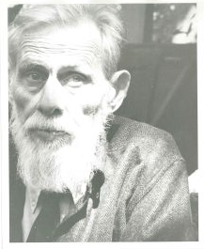
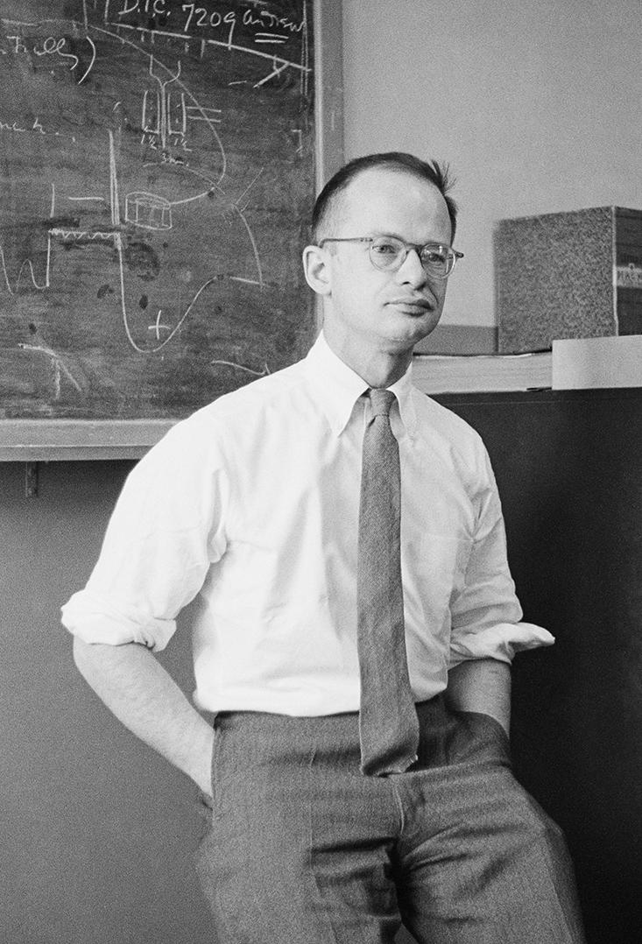
McCulloch-Pitts Neuron
The McCulloch-Pitts (MP) neuron, developed in 1943 by Warren McCulloch and Walter Pitts, is one of the earliest models of artificial neurons. It's a very simplified version of a biological neuron.
Warren Sturgis McCulloch (1898-1969)
Walter Pitts (1923-1969)
Notes:
Now that we have established how a biological neuron works, lets look at what is McCulloch-Pitts Neuron.
The first computational model of a neuron was proposed by McCulloch (neuroscientist) and PITTS (logician) in 1943.

Slide 9
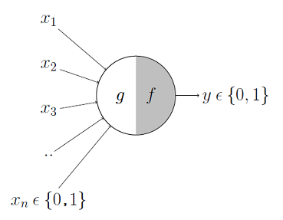
McCulloch-Pitts Neuron
M-P Neuron: A Concise Representation
!
!
Notes:
It may be divided into 2 parts. The first part, g takes an input, performs an aggregation and based on the aggregated value. The second part, f makes a decision.

Slide 10
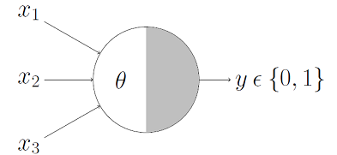
Boolean Functions Using M-P Neuron
This representation just denotes that, for the Boolean inputs x_1, x_2 and x_3 if the g(x) ≥ theta i.e., sum ≥ theta, the neuron will fire, otherwise, it won’t.
Notes:
So far we have seen how the M-P neuron works. Now lets look at how this neuron can be used to represent a few boolean functions. Mind you that our inputs are all boolean and the output is also boolean so essentially, the neuron is just trying to learn a boolean function. A lot of boolean decision problems can be cast into this, based on appropriate input variables

Slide 11
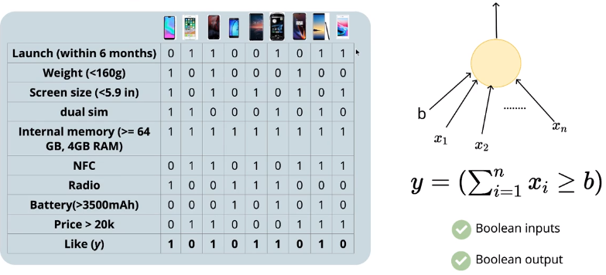
Boolean Functions Using M-P Neuron
Mobile data
Notes:
The McCulloch-Pitts neuron also has many real-life applications. For example, here are many cell phones, you want to know whether you like them or not, here are many parameters related to cell phones, use these parameters as input, set a threshold parameter, when the sum of the input values is greater than the set threshold parameter, it means you like this phone.

Slide 12
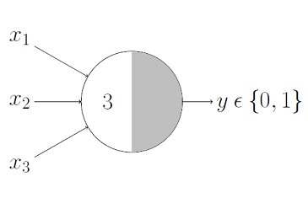
Boolean Functions Using M-P Neuron
AND Function
Notes:
An AND function neuron would only fire when ALL the inputs are ON i.e., g(x) ≥ 3 here.

Slide 13

Boolean Functions Using M-P Neuron
OR Function
Notes:
OR function neuron would fire if ANY of the inputs is ON i.e., g(x) ≥ 1 here.

Slide 14
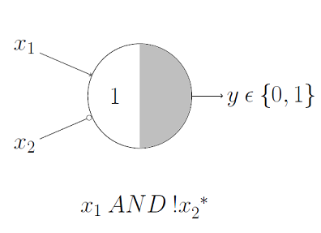
Boolean Functions Using M-P Neuron
A Function With An Inhibitory Input
Notes:
Here, we have an inhibitory input i.e., x_2, so whenever x_2 is 1, the output will be 0. Keeping that in mind, we know that x_1 AND !x_2 would output 1 only when x_1 is 1 and x_2 is 0 so it is obvious that the threshold parameter should be 1.
(Lets verify that, the g(x) i.e., x_1 + x_2 would be ≥ 1 in only 3 cases:
Case 1: when x_1 is 1 and x_2 is 0 Case 2: when x_1 is 1 and x_2 is 1 Case 3: when x_1 is 0 and x_2 is 1
But in both Case 2 and Case 3, we know that the output will be 0 because x_2 is 1 in both of them, thanks to the inhibition. And we also know that x_1 AND !x_2 would output 1 for Case 1 (above) so our thresholding parameter holds good for the given function.)

Slide 15
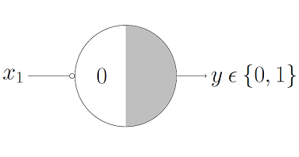
Boolean Functions Using M-P Neuron
NOT Function
Notes:
For a NOT neuron, 1 outputs 0 and 0 outputs 1. So we take the input as an inhibitory input and set the thresholding parameter to 0. It works!

Slide 16
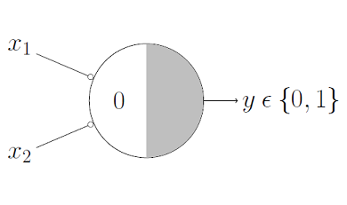
Boolean Functions Using M-P Neuron
NOR Function
Notes:
For a NOR neuron to fire, we want ALL the inputs to be 0 so the thresholding parameter should also be 0 and we take them all as inhibitory input.

Slide 17
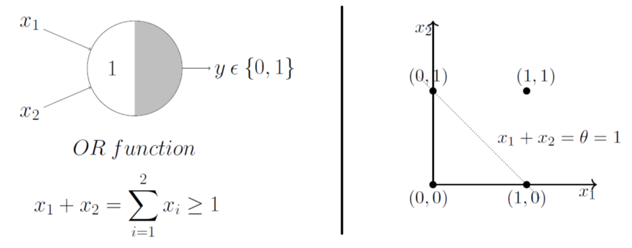
Geometric Interpretation Of M-P Neuron
OR Function
Notes:
Moving on now to Geometric interpretation of M-P neuron.
Lets start with the OR function.
We already discussed that the OR function’s thresholding parameter theta is 1, for obvious reasons. The inputs are obviously boolean, so only 4 combinations are possible — (0,0), (0,1), (1,0) and (1,1). Now plotting them on a 2D graph and making use of the OR function’s aggregation equation
i.e., x_1 + x_2 ≥ 1 using which we can draw the decision boundary as shown in the graph below.
We just used the aggregation equation i.e., x_1 + x_2 =1 to graphically show that all those inputs whose output when passed through the OR function M-P neuron lie ON or ABOVE that line and all the input points that lie BELOW that line are going to output 0.
This Graph shows that the M-P neuron can learn a linear decision boundary! The M-P neuron is splitting the input sets into two classes — positive and negative. Positive ones (which output 1) are those that lie ON or ABOVE the decision boundary and negative ones (which output 0) are those that lie BELOW the decision boundary.

Slide 18
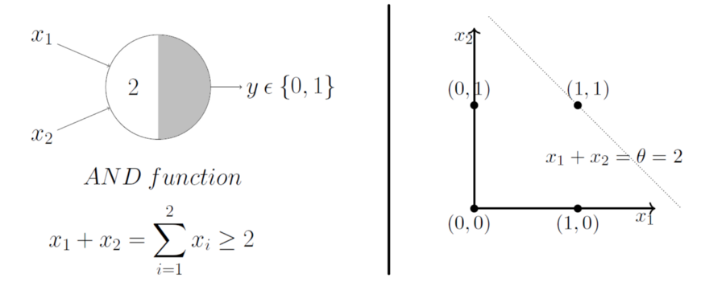
Geometric Interpretation Of M-P Neuron
AND Function
Notes:
Lets do the same for all the boolean functions by looking at more examples (if it is not already clear from the math).
In this case, the decision boundary equation is x_1 + x_2 =2. Here, all the input points that lie ON or ABOVE, just (1,1), output 1 when passed through the AND function M-P neuron. It fits! The decision boundary works!

Slide 19
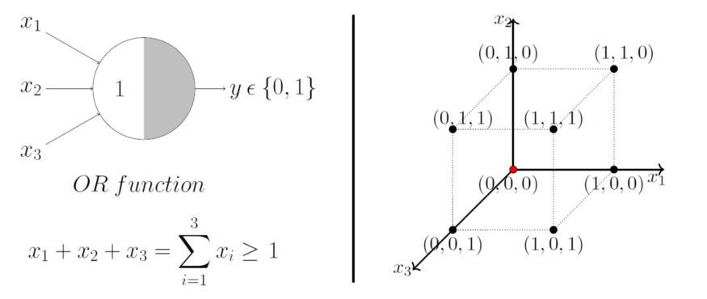
Geometric Interpretation Of M-P Neuron
OR Function With 3 Inputs
Notes:
Lets just generalize this by looking at a 3 input OR function M-P unit. In this case, the possible inputs are 8 points — (0,0,0), (0,0,1), (0,1,0), (1,0,0), (1,0,1),… you got the point(s). We can map these on a 3D graph and I give 2 minutes to draw a decision boundary in 3 dimensions.

Slide 20
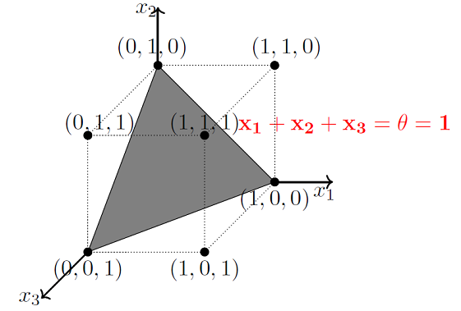
Geometric Interpretation Of M-P Neuron
Notes:
The decision boundary is a PLANE!
The plane that satisfies the decision boundary equation x_1 + x_2 + x_3 = 1 is shown below:
From the picture, all the points that lie ON or ABOVE that plane (positive half space) will result in output 1 when passed through the OR function M-P unit and all the points that lie BELOW that plane (negative half space) will result in output 0.
Just by hand setting a thresholding parameter, M-P neuron is able to conveniently represent the boolean functions which are linearly separable.

Slide 21
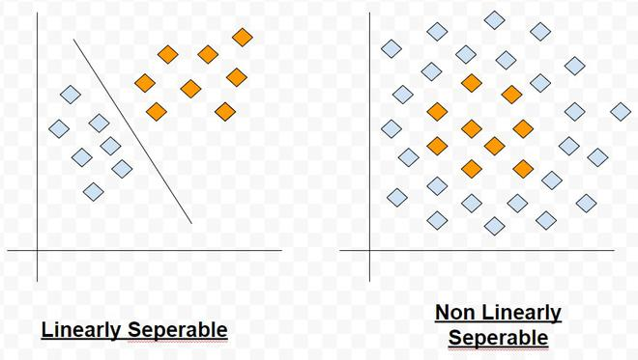
Geometric Interpretation Of M-P Neuron
Linear separability (for boolean functions): There exists a line (plane) such that all inputs which produce a 1 lie on one side of the line (plane) and all inputs which produce a 0 lie on other side of the line (plane).

Slide 22
Limitations Of M-P Neuron
What about functions which are not linearly separable? e.g., XOR function.
What about non-Boolean (e.g., real) inputs?
Do we always need to hand code the threshold?
Are all inputs equal? What if we want to assign more importance to some inputs?
Notes:
allows binary states only.

Slide 23

Perceptron
Frank Rosenblatt (July 11, 1928 – July 11, 1971) was an American psychologist notable in the field of artificial intelligent. He is sometimes called the father of deep learning.
In 1957 he started something really big. He "invented" a Perceptron program, on an IBM 704 computer at Cornell Aeronautical Laboratory.
Scientists had discovered that brain cells (Neurons) receive input from our senses by electrical signals.
The Neurons, then again, use electrical signals to store information, and to make decisions based on previous input.
Frank had the idea that Perceptrons could simulate brain principles, with the ability to learn and make decisions.
Notes:
In the views that the M-P neuron is not weighted and cannot process non-Boolean input, perceptron is proposed. This model was developed by Frank Rosenblatt in 1957.

Slide 24
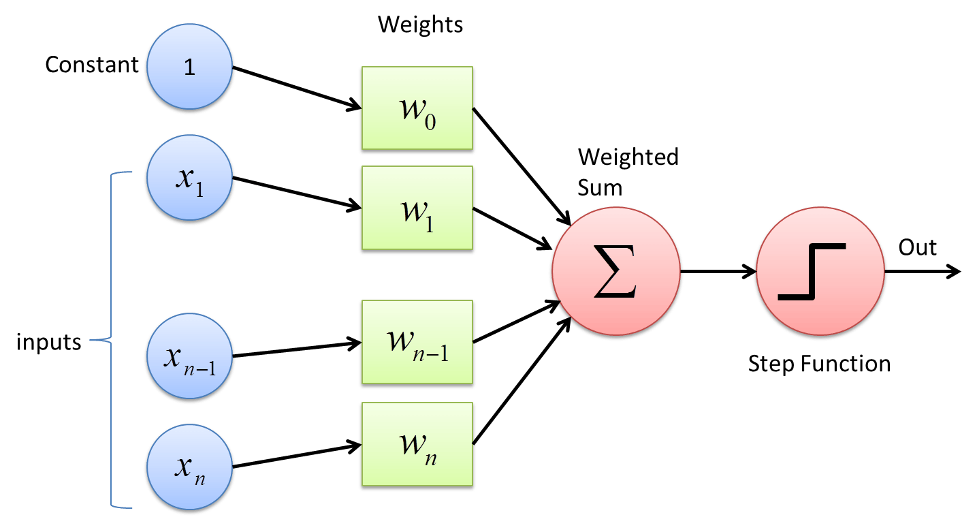
Perceptron
Notes:
The process begins by taking all the input values and multiplying them by their weights. Then, all of these multiplied values are added together to create the weighted sum. The weighted sum is then applied to the activation function, producing the perceptron's output. The activation function plays the integral role of ensuring the output is mapped between required values such as (0,1) or (-1,1). It is important to note that the weight of an input is indicative of the strength of a node. Similarly, an input's bias value gives the ability to shift the activation function curve up or down.

Slide 25
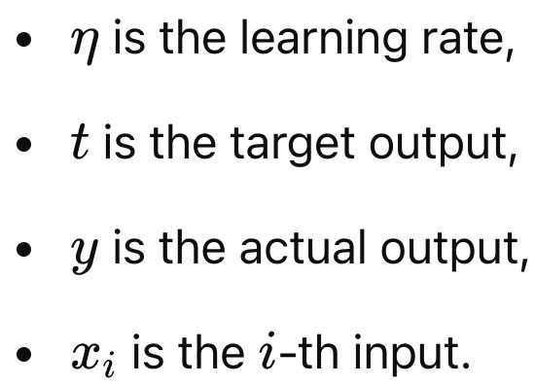
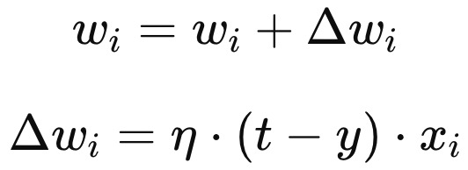

Perceptron
Training the Perceptron (Learning Algorithm)
Initialization: Start by initializing the weights and bias with small random values.
For each training example x:
Compute the output y based on the current weights and bias.
Update the weights and bias if the prediction is incorrect:
Update the bias b similarly:
Repeat the process until all training examples are correctly classified or the algorithm converges.

Slide 26
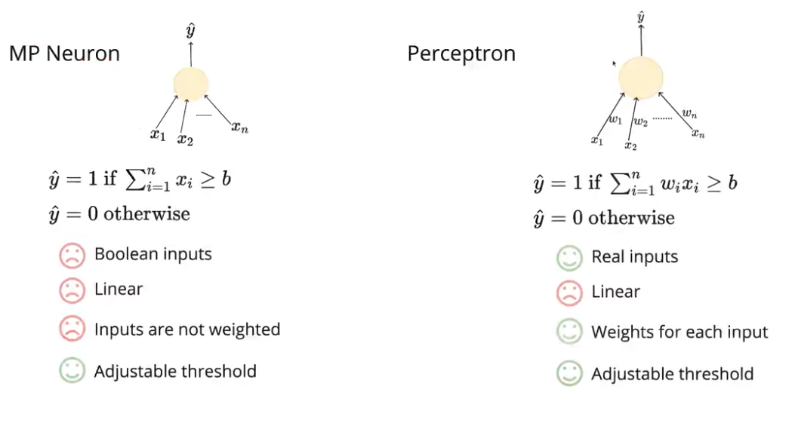
MP Neuron vs. Perceptron
Both, MP Neuron Model as well as the Perceptron model work on linearly separable data.
MP Neuron Model only accepts Boolean input whereas Perceptron Model can process any real input.
While using both the models we can adjust threshold input to make the model fit our the dataset.
Notes:
Let’s turn now to comparison between MP Neuron Model and Perceptron Model

Slide 27
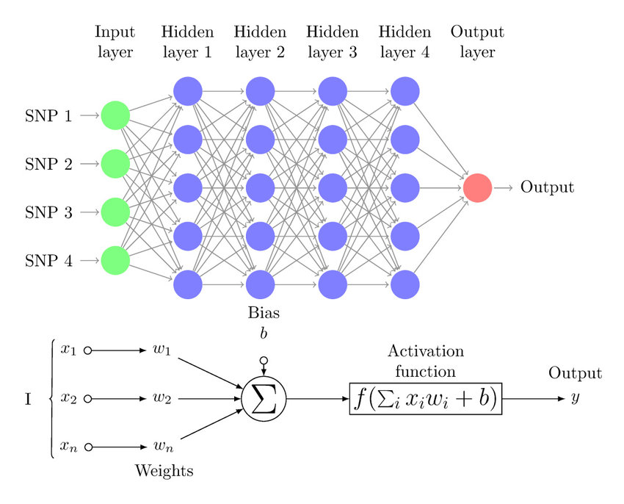
Multilayer Perceptrons
A multilayer perceptron is a type of feedforward neural network consisting of fully connected neurons with a nonlinear kind of activation function.

Slide 28
Multilayer Perceptrons
Input layer
The input layer consists of nodes or neurons that receive the initial input data. The number of neurons in the input layer is determined by the dimensionality of the input data.

Slide 29
Multilayer Perceptrons
Hidden layer
Between the input and output layers, there can be one or more layers of neurons. The number of hidden layers and the number of neurons in each hidden layer are hyperparameters that need to be determined during the model design phase.

Slide 30
Multilayer Perceptrons
Output layer
This layer consists of neurons that produce the final output of the network. The number of neurons in the output layer depends on the nature of the task.

Slide 31
Multilayer Perceptrons
Weights
Neurons in adjacent layers are fully connected to each other. Each connection has an associated weight, which determines the strength of the connection. These weights are learned during the training process.
Bias neurons
In addition to the input and hidden neurons, each layer (except the input layer) usually includes a bias neuron that provides a constant input to the neurons in the next layer. Bias neurons have their own weight associated with each connection, which is also learned during training.

Slide 32
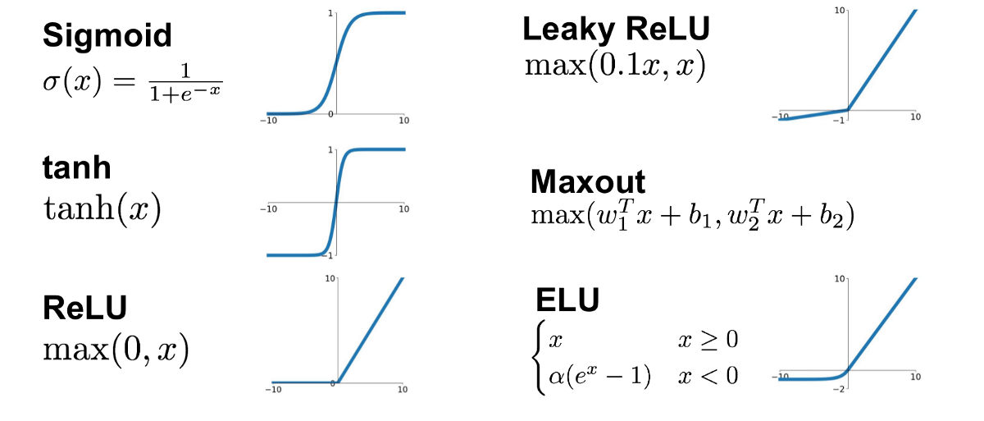
Multilayer Perceptrons
Activation function
Typically, each neuron in the hidden layers and the output layer applies an activation function to its weighted sum of inputs. Common activation functions include sigmoid, tanh, ReLU (Rectified Linear Unit), and soft-max. These functions introduce nonlinearity into the network, allowing it to learn complex patterns in the data.

Slide 33
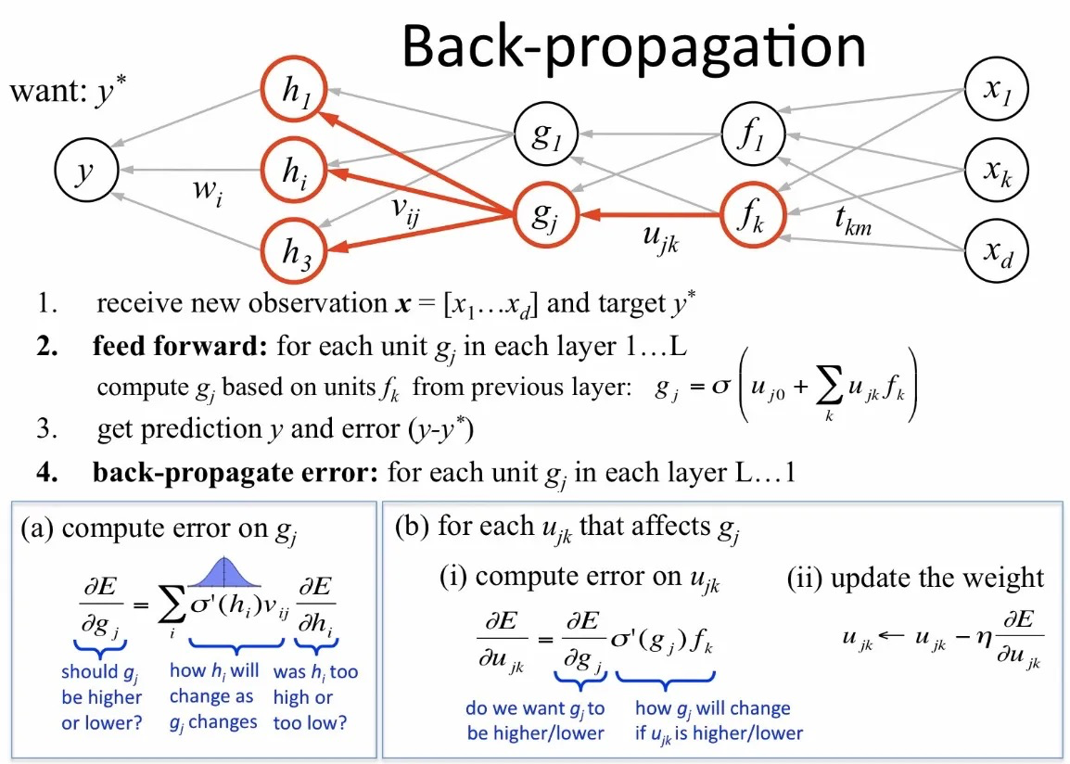
Multilayer Perceptrons
Training with backpropagation
Notes:
Calculate the gradient (how much change is needed) of the error with respect to each weight.
Update the weights in the opposite direction of the gradient to reduce the error.

Slide 34
Thanks

Slide 35
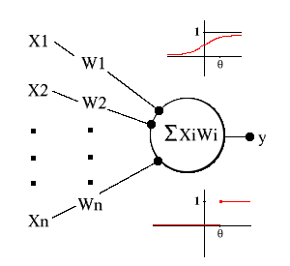
Threshold Logic Units
The Threshold Logic Unit (TLU) is a basic form of machine learning model consisting of a single input unit (and corresponding weights), and an activation function.
Note that the TLU is the most basic form of AI neuron/computational unit, knowledge of which will lay the foundation for advanced topics in machine learning and deep learning.

Slide 36
Threshold Logic Units
It natural to model neurons as threshold logic units: if a neuron receives enough excitatory input that is not compensated by equally strong inhibitory input, it becomes active and sends a signal to other neurons. Such a model was already examined very early in much detail by McCulloch and Pitts (1943). As a consequence, threshold logic units are also known as McCulloch–Pitts neurons. Another name which is commonly used for a threshold logic unit is perceptron, even though the processing units that Rosenblatt (1958, 1962) called “perceptrons” are actually somewhat more complex than simple threshold logic units.^{[1]}
[1] J.A. Anderson and E. Rosenfeld. Neurocomputing: Foundations of Research. MIT Press, Cambridge, MA, USA, 1988

